Slide 1
Al-based tool for preliminary diagnosis of Dermatological manifestations
CSE7101- Capstone Project
Review-5
Batch Number: CIT_23
Under the Supervision of,
Dr. Mohammad Buran Basha
Assistant Professor
Presidency School of Engineering, Department of Electronics and Communication Engineering
Roll Number | Student Name
20221CIT0085 | VINOD
20221CIT0077 | NALLIN KUMAR AB
20221CIT0068 | DEEKSHA D
Name of the Program: CIT-Computer Science & Engineering (Internet of Things)
Name of the HoD: Dr. Anandaraj S.P
Name of the Program Project Coordinator: Dr. Sharmasth Vali
Name of the School Project Coordinators: Dr. Sampath A K , Dr. Geetha Arjunan

Slide 2
Content
Introduction
Abstract
Algorithm Details
Results
Timeline of the project
References

Slide 3
Introduction:
Skin diseases are among the leading causes of non-fatal disease burden globally, significantly impacting mental health, daily functioning, social participation, and quality of life.
In India, the shortage of trained dermatologists—especially in rural and semi-urban regions—results in delayed diagnosis, misdiagnosis, and unsafe self-treatment.
Due to the lack of accessible dermatological services and poor medical awareness, many individuals rely on home remedies or non-professional advice.
There is an urgent need for an AI-based preliminary screening tool that can assist early detection and guide patients with reliable information.

Slide 4
Abstract
This project presents an AI-based skin disease diagnostic system that uses ResNet-50 deep learning architecture to classify skin conditions based on uploaded images and a GPT-powered chatbot to provide structured medical explanations.
The system identifies visual patterns in dermatological images and generates useful guidance including symptoms, causes, treatment recommendations, and prevention measures.
Accessible through a web-based interface, the system is designed to support preliminary screening and improve healthcare accessibility in resource-constrained regions.
The model demonstrates over 91% accuracy, proving its potential as a scalable and reliable diagnostic support solution.

Slide 5
Algorithm Details
1. Skin Disease Classification — ResNet50 (Convolutional Neural Network)
The skin disease classification module uses a deep convolutional neural network, ResNet50, to automatically identify and classify skin conditions from uploaded images.
ResNet50 consists of 50 layers and uses residual connections, which allow the network to train efficiently and avoid the vanishing gradient problem.
The network extracts important visual features, including color variations, texture patterns, lesions, and rashes, to accurately differentiate between multiple skin disease categories.
The model is trained using CrossEntropyLoss, which calculates the error between predicted probabilities and the actual disease labels.
Stochastic Gradient Descent (SGD) with momentum is used to optimize the model weights, ensuring stable and effective learning during training.
A batch size of 32 is used to balance memory usage and improve training stability.

Slide 6
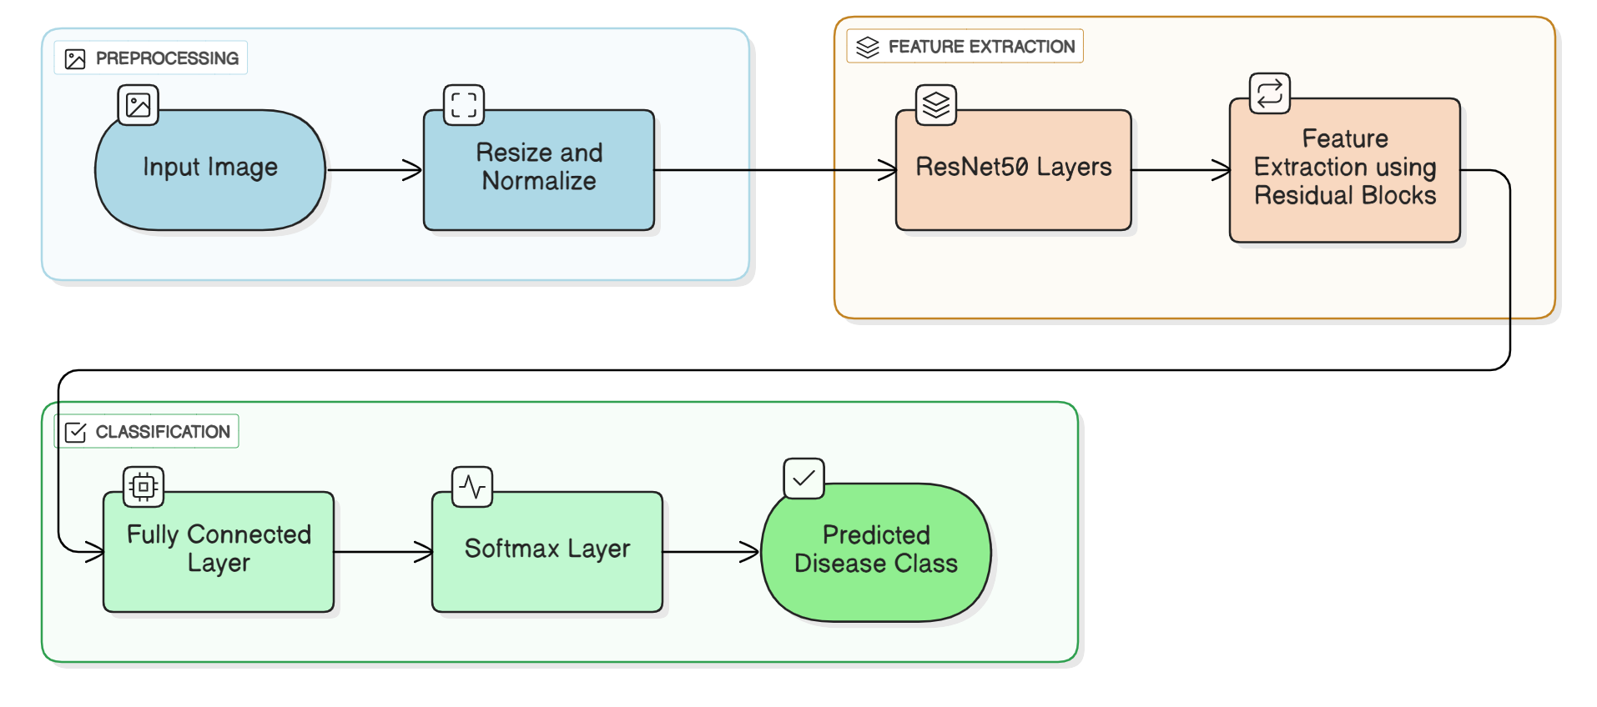
Algorithm Details
Skin Disease Classification — ResNet50 (Convolutional Neural Network)

Slide 7
Algorithm Details
1. Pre-processing
Input Image: The raw image of the skin condition uploaded by the user.
Resize and Normalize: The image is resized to a fixed dimension (224×224) and normalized so that the pixel values are suitable for the neural network.
2. Feature Extraction
ResNet50 Layers: These layers perform convolution operations to detect features like edges, textures, and color
variations.
Feature Extraction using Residual Blocks: This step captures complex patterns required to distinguish between skin
diseases.
3. Classification
Fully Connected Layer: After feature extraction, the network uses a fully connected layer to combine features & prepare
them for classification.
Softmax Layer: This layer converts the output of the fully connected layer into a probability distribution across all
possible skin disease classes.
Predicted Disease Class: The class with the highest probability is selected as the predicted skin disease.

Slide 8
Algorithm Details
2. Chatbot Response Generation — GPT-4o-mini
The chatbot module uses OpenAI GPT-4o-mini to provide step-by-step and user-friendly explanations about the predicted skin disease.
The system applies prompt engineering to ensure that the AI response is structured and covers the disease definition, causes, key symptoms, treatment steps, and preventive measures.
The predicted disease and the user query are used as input to the GPT model, which generates a well-organized response in bullet-point format.
This approach allows the user to easily understand the condition and follow recommended guidelines.

Slide 9
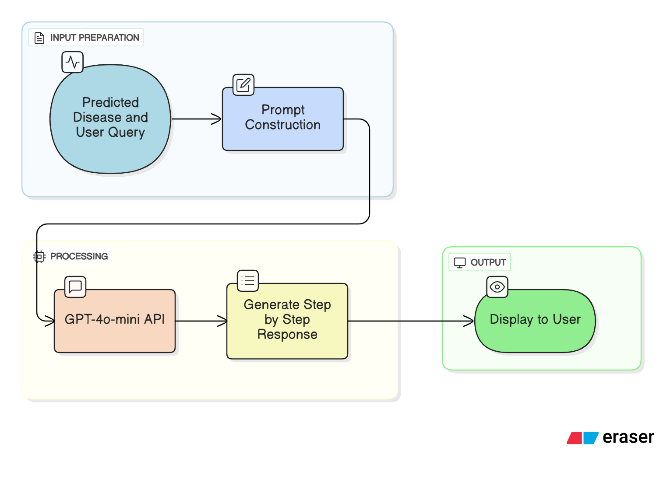
Algorithm Details
2. Chatbot Response Generation — GPT-4o-mini

Slide 10
Algorithm Details
1. Input Preparation
Predicted Disease and User Query: This module takes the disease predicted by ResNet50 and the user’s
question about the condition as input.
Prompt Construction: A structured prompt is created for GPT-4o-mini. This prompt guides the AI to
provide a step-by-step, clear, and comprehensive answer.
2. Processing
GPT-4o-mini API: The AI model processes the prompt. It leverages its natural language understanding to
generate a human-readable response in a structured format.
Generate Step-by-Step Response: The model outputs the response covering what the disease is, its causes,
symptoms, treatment, and prevention.
3. Output
Display to User: The generated response is displayed in the web application interface for the user to read and
follow. This module ensures that the user receives actionable information in an easy-to-understand format.

Slide 11
Results
The model training process was successful, as the training loss consistently decreased from 4.17 to 0.66, showing that the model effectively learned from the dataset
The trained model achieved an accuracy of 91.43% on the training data, which reflects strong performance in capturing the underlying patterns.
This reduction in loss and high accuracy indicate strong convergence, meaning the model is now capable of making accurate predictions on unseen data.
When used, the output will provide predictions in the form of classified results (for example, identifying the correct category of input data).
Along with predictions, the user will also see evaluation metrics such as accuracy, precision, recall, and F1-score, which provide a clear measure of how well the model is performing.
Overall, the results show that the trained model is ready for deployment and will deliver reliable outputs that are easy for end-users to interpret.

Slide 12
Timeline of the Project
Review 1 – Project Initiation & Literature
Defined problem statement, objectives, and scope documentation.
Review 2 – Design & Methodology
Built a basic ML model for skin disease classification.
Review 3 – Clarifying Phase
Designed and developed a dedicated web application.
Proposed datasets and methodology for AI-based diagnosis.
Outlined project objectives with planned tech stack.
Presented initial approach through an introductory presentation.
Hosted the trained model on a backend server.
Created a simple web interface for image upload and testing.
Demonstrated working predictions via a functional web page.
Integrated the ML model into the web using TensorFlow Lite.
Added login credentials with role-based access for different users.
Review 4 – Refinement & Pre-Final Stage.
Integrated web app, backend, and chatbot into a unified system.
Review 5 – Final Submission
Finalized deployment of the AI-based web diagnostic tool.
Ensured security by restricting access so users cannot view others’ uploaded images.
Conducted extensive testing, validation, and pilot user trials.
Fixed bugs, optimized performance, and improved interface.
Drafted the final report and prepared for closing review.
Completed full documentation, thesis, and project report.
Prepared and delivered final presentation with a live demo.
Submitted project deliverables and attended viva evaluation.

Slide 13
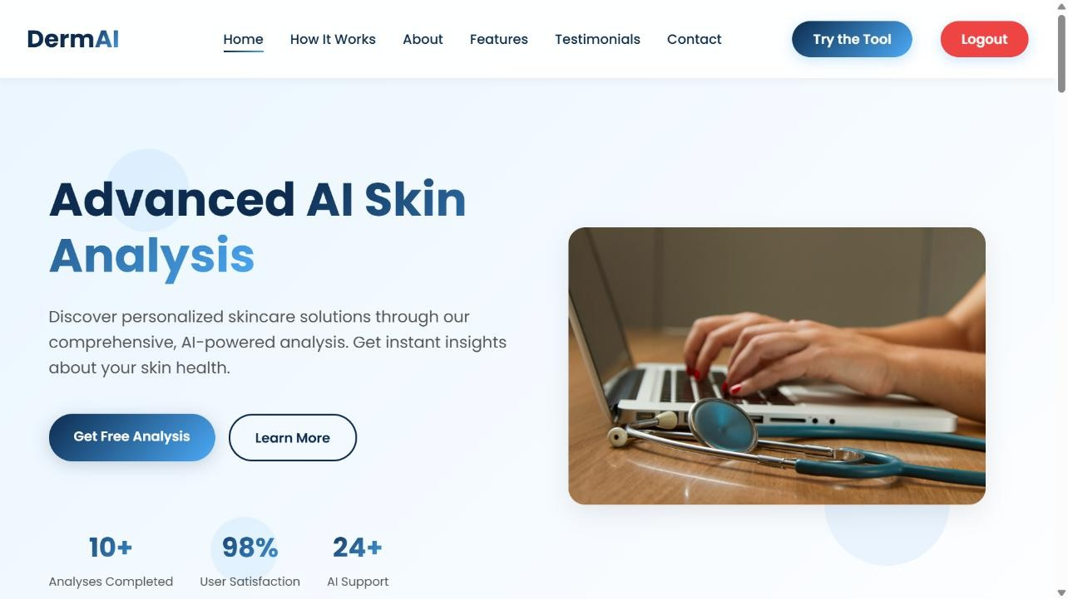
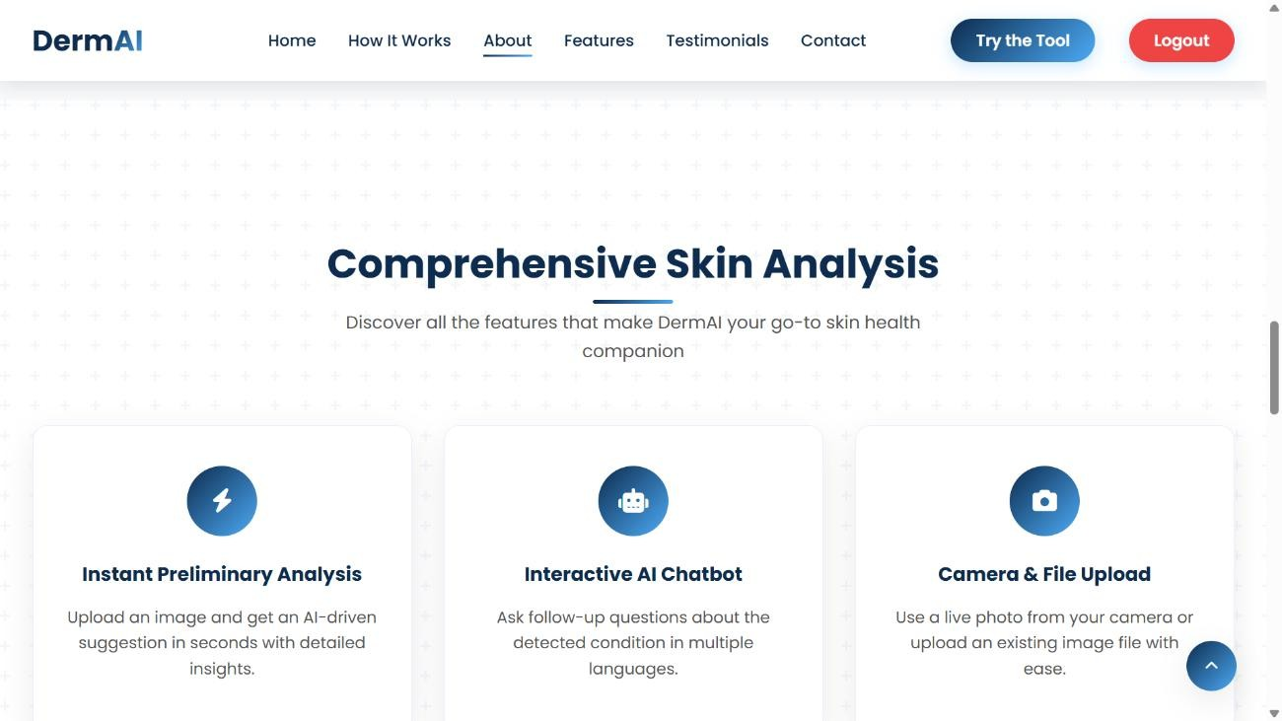
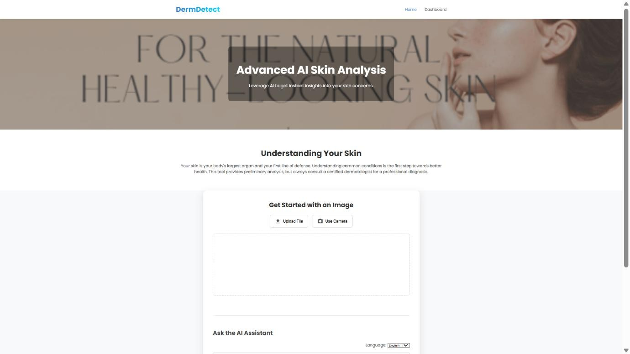
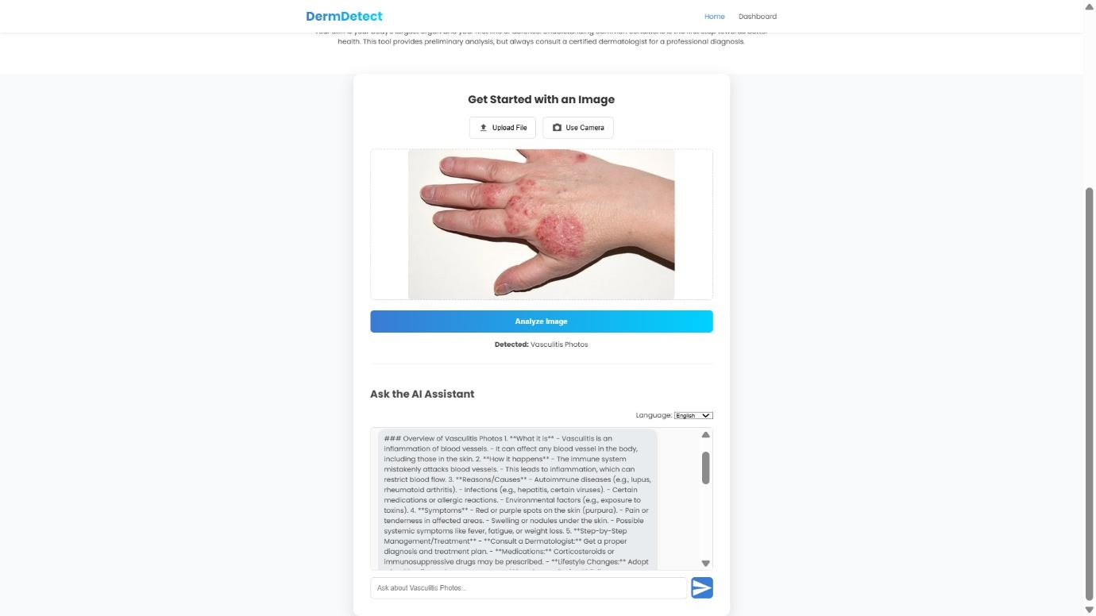
Images

Slide 14


